Slide 1
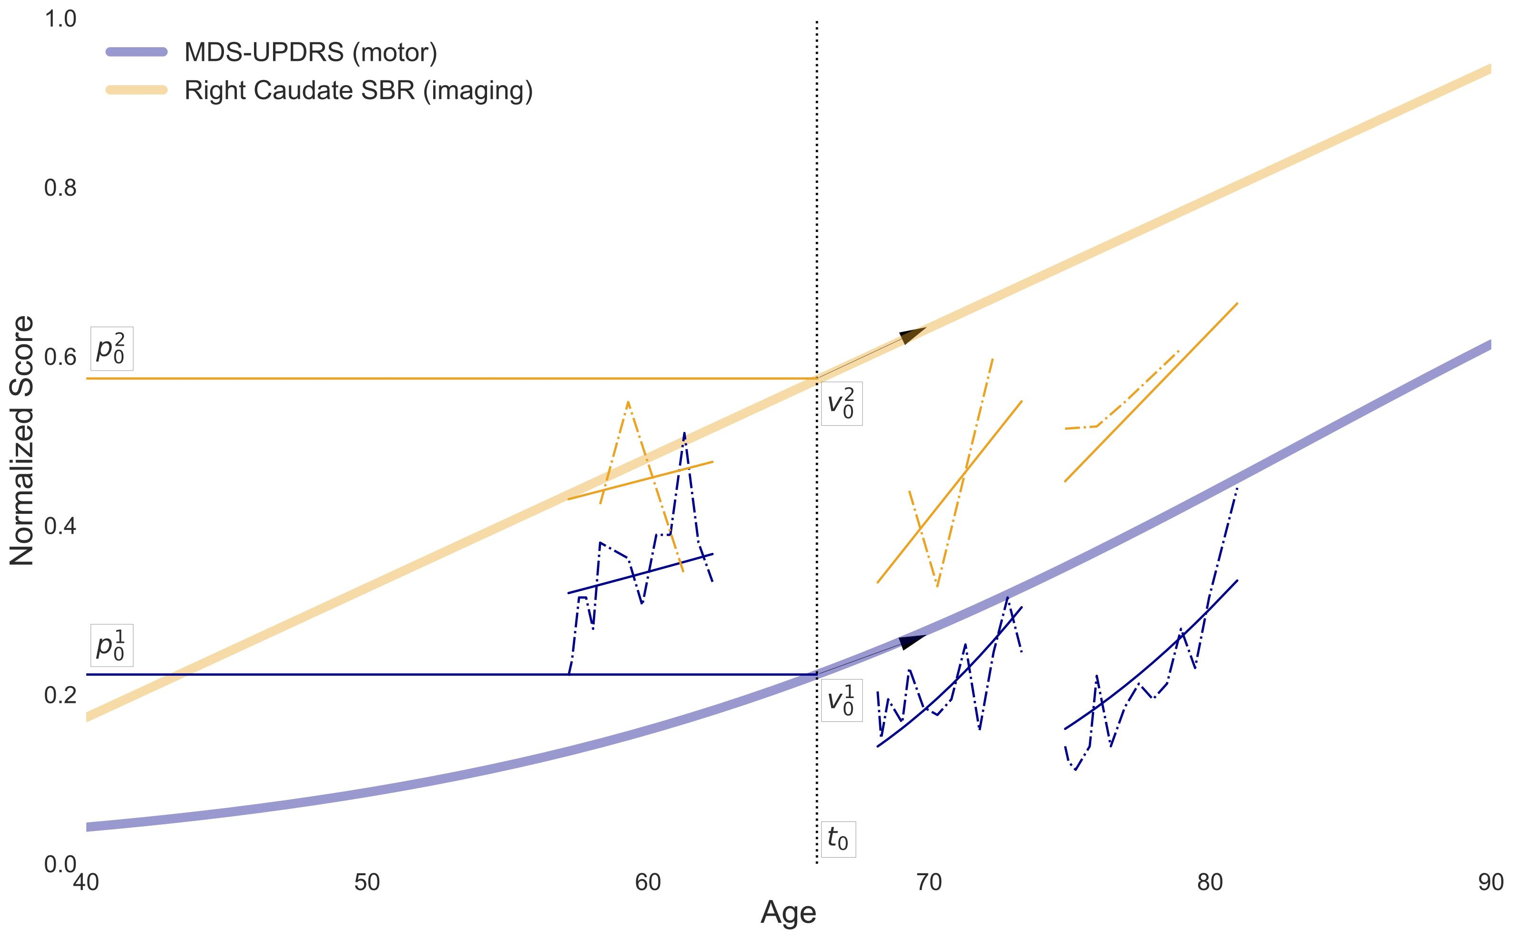
Learning disease progression models with longitudinal data and missing values. R. Couronne, M. Vidailhet, JC. Corvol, S. Lehéricy, S. Durrleman. ISBI, April 2019

Slide 2
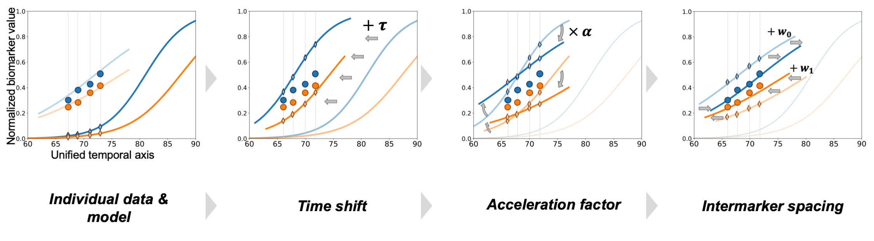
https://disease-progression-modelling.github.io/pages/models/disease_course_mapping.html

